Slide 1
COVID REPORT
Data with charts

Slide 2
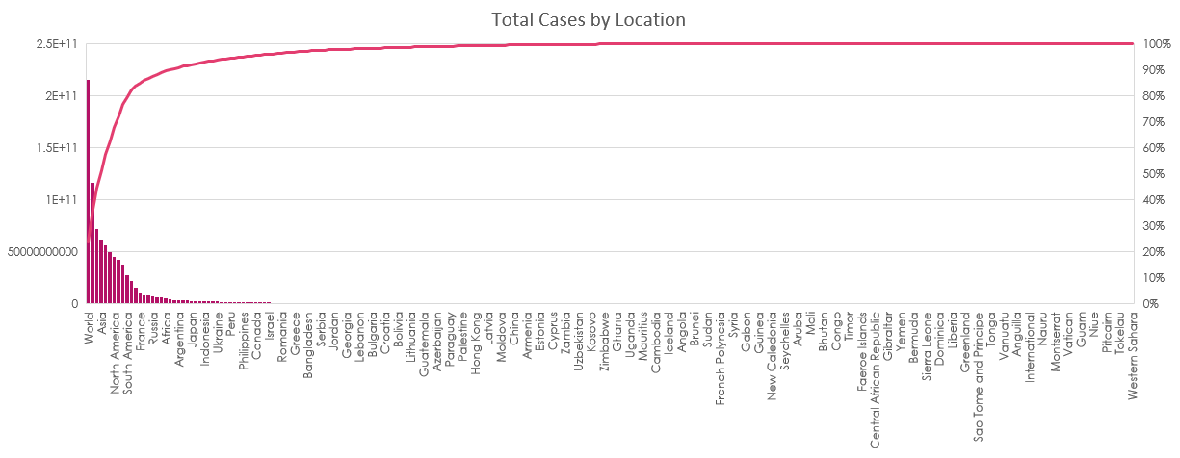
Total Cases By Location

Slide 3
Total Cases By Date

Slide 4
Count Of Patients in Hospital by Location

Slide 5
Total Deaths

Slide 6
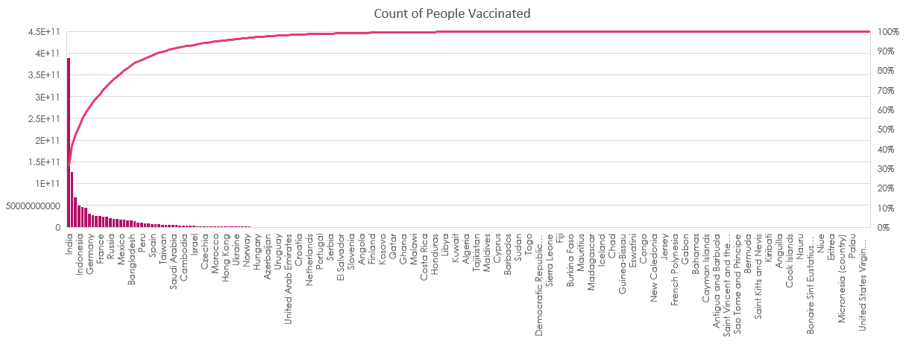
Number of people Vaccinated

Slide 7
Population Density

Slide 8
Population Density by Continent

Slide 9
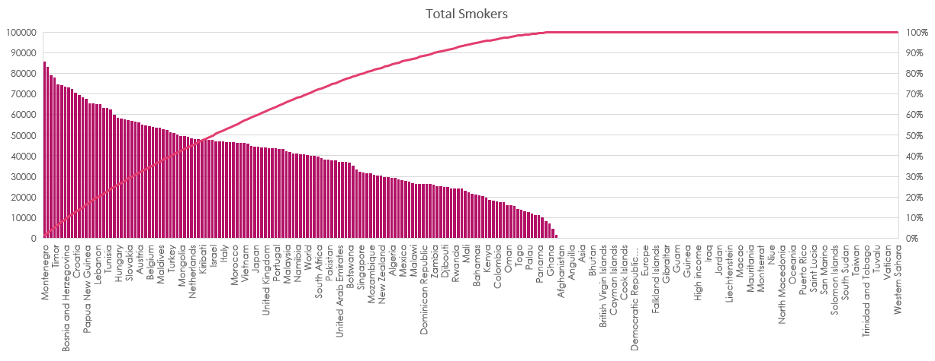
Count of Smokers

Slide 10
THANK YOU

